Slide 1
Ggplot2 and interactive graphics with R
Christophe Ladroue
SECTION 03
VIDEO 02
Using size and colour
www.PacktPub.com

Slide 2
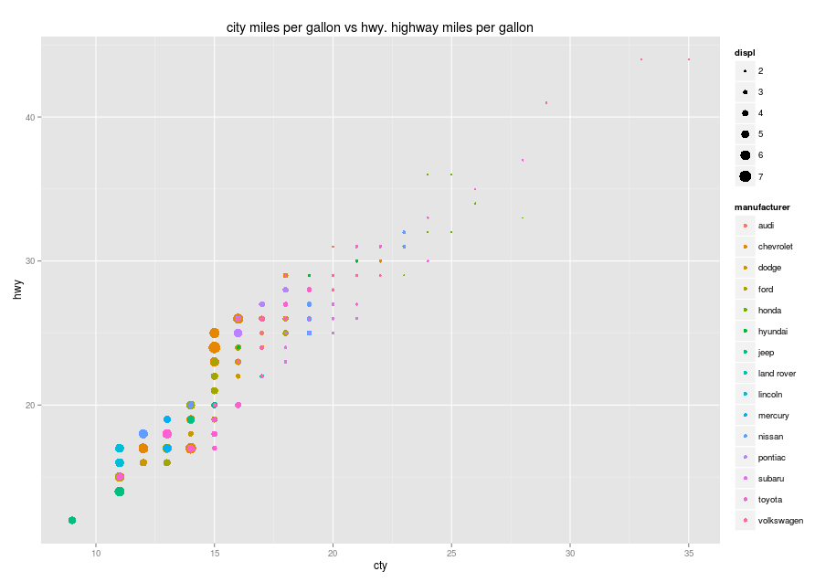
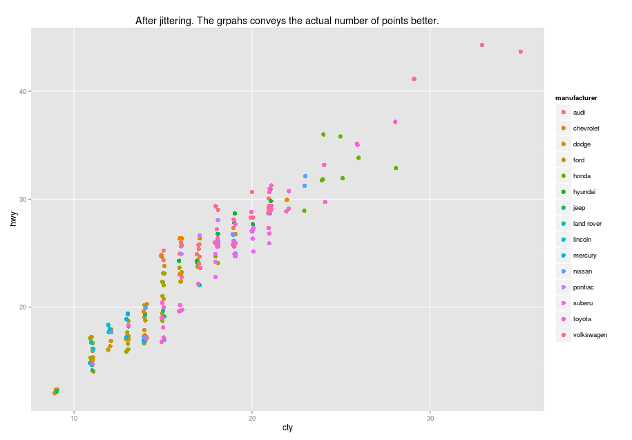
In this video we took a look at
the dataset mpg, a collection of cars’ features.
how to add extra dimensions to your graph by mapping more aesthetics.
Next: minimizing overplotting

